Slide 1
Capstone Updates
Isaac Peabody
11/21/2024

Slide 2
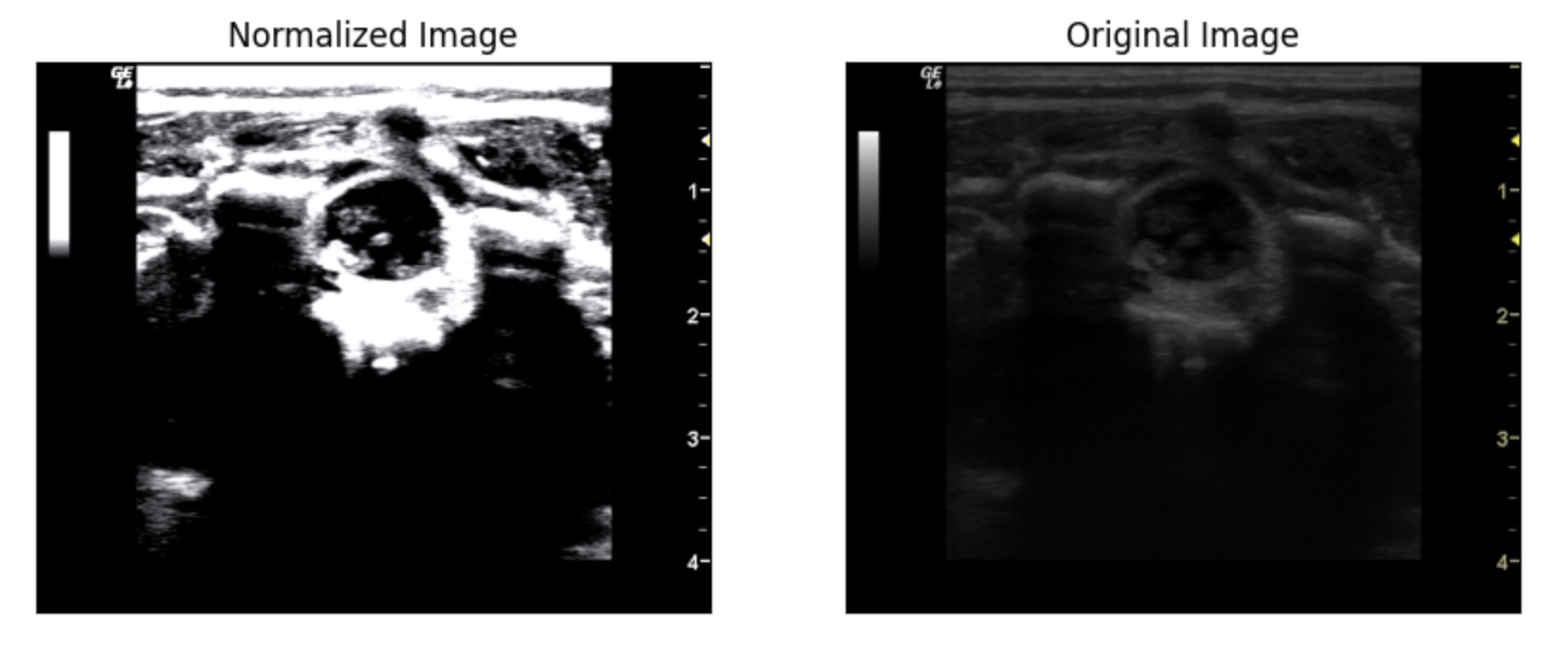
Current Goal: Adapt models so that we achieve better generalizability
Currently training models on combination of “old” images and “new” images: total of 27 videos (4,071 frames)
In addition to train-val-test split, want to check performance on unseen set of 32 images
Can adjust model fit via augmentation parameters: current focus on cropping
Additional benefit: can help prevent models pulling information from image text, which we do not want
Crop + Norm
Example:

Slide 3
Cropping Workflow:
Within the train set:
Randomly select between no cropping, center cropping, vertical cropping, and horizontal cropping
Set the cropping percentage based on how much of the original image should be kept
Crop image based on the above selection, and use for training
Original Image
Center Crop
One of:
Vertical Crop
Horizontal Crop

Slide 4
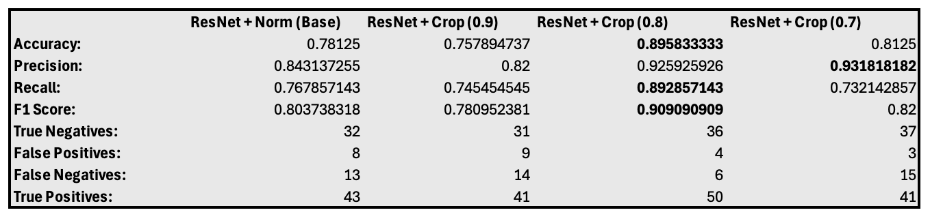
Cropping Results:
Tested several cropping configurations to compare, specifically:
No cropping
10% cropping (90% of original image kept)
20% cropping (80% of original image kept)
30% cropping (70% of original image kept)
Want to find balance between increased generalization and data quality loss
Looking specifically at performance on the unseen images

